Slide 1
2025
Sales
Analysis
By Manan Shah
Page
01

Slide 2

Company Background
Founded in 2007 by Sachin Bansal and Binny Bansal, Flipkart started as an online bookstore and later expanded into various categories like electronics, fashion, home essentials, and more.
Headquartered in Bengaluru, India, Flipkart is one of the leading e-commerce companies in the country, competing closely with Amazon India.
In 2018, Walmart acquired a 77% stake in Flipkart for $16 billion, marking one of the largest e-commerce deals globally.
Flipkart owns several popular subsidiaries, including Myntra (fashion and lifestyle) and PhonePe (digital payments, now spun off), and it plays a major role in driving online shopping growth in India.
Page
02

Slide 3
Problem Statement
Flipkart company is facing operational challenges that are affecting its growth and customer satisfaction. Despite the growing demand in online retail, inefficiencies in logistics, high cancellation rates, suboptimal inventory management, and poor customer retention are hindering performance. The company lacks clarity on which fulfillment methods are more reliable, which products are in high demand or problematic, and how to effectively serve high-value customers. There is an urgent need to leverage data-driven insights to streamline operations, improve customer satisfaction, and boost overall profitability.
Page
03

Slide 4
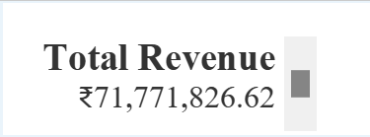
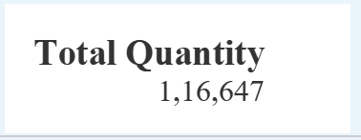
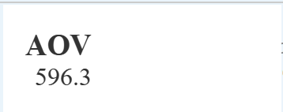
KPI’s
Key Performance Indicators
This dashboard presents four key performance indicators (KPIs) at the top:
Total Revenue: ₹71,771,826.62 — This figure reflects the overall revenue generated.
Total Quantity: 116,647 — This is the total number of items sold.
Average Order Value (AOV): ₹596.3 — This shows the average amount spent per order.
Canceled Orders: 20,453 — Indicates the total number of canceled transactions.
These KPIs provide a quick snapshot of the business's sales performance.
Page
04

Slide 5
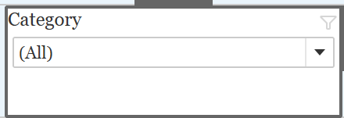
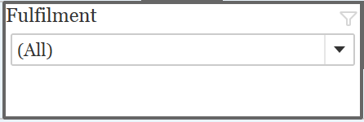

Filters
The dashboard provides four filters to refine the data:
Size Filter: Allows users to view performance metrics based on product size.
Month Filter: Filters data by specific months to enable time-based analysis.
Category Filter: Enables users to analyze data for specific product categories.
Fulfillment Filter: Lets users distinguish between sales fulfilled by Amazon vs. merchant partners.
These filters offer dynamic control over the data being visualized and help in drawing targeted insights.
Page
05

Slide 6
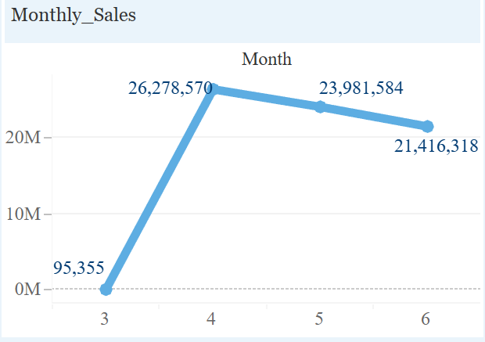
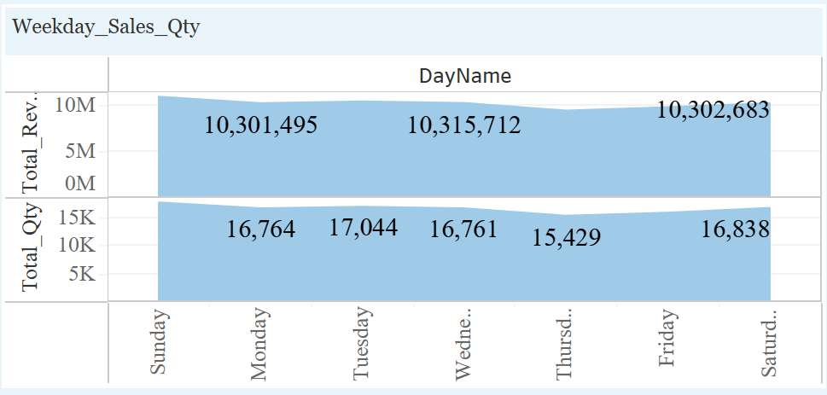
Charts
Monthly Sales (Line Chart)
Displays the sales revenue over different months.
A noticeable spike is observed in April with ₹26,278,570 in revenue, followed by a slight decline in the following months.
Weekly Sales Analysis (Bar Chart)
Shows the sales quantity and revenue by day of the week.
Monday and Wednesday see the highest revenue, around ₹10.3M, while quantity remains consistent across all days.
Page
06

Slide 7
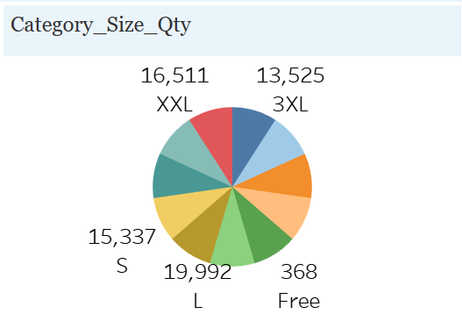
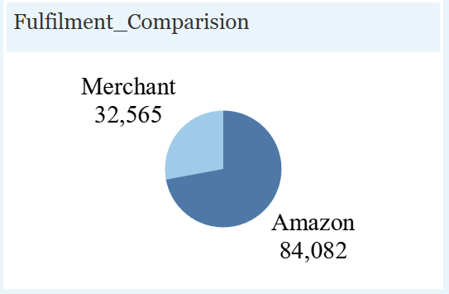
Category Size Quantity (Pie Chart)
Represents sales quantity across different sizes.
Sizes like XXL, S, and L are the top-selling categories, with XXL leading at 16,511 units.
Fulfilment Comparison (Pie Chart)
Compares order fulfillment between Amazon and Merchant.
Amazon fulfills the majority with 84,082 orders, while Merchants fulfill 32,565.
Page
07

Slide 8
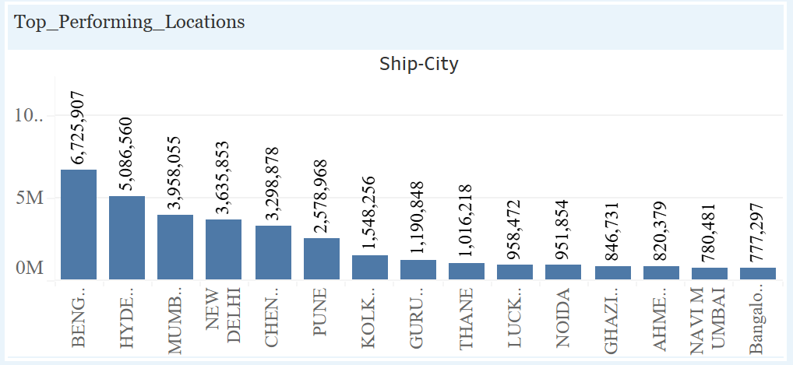
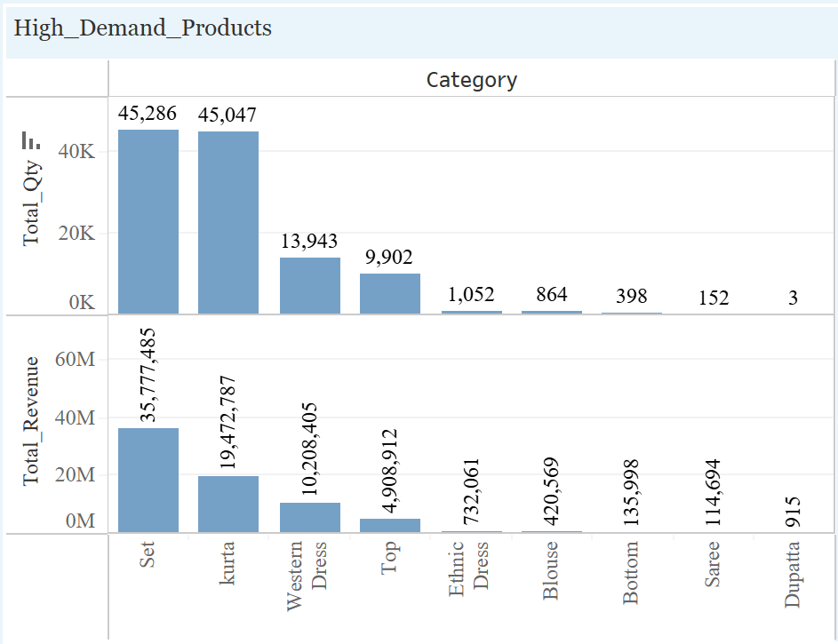
Top Performing Locations (Bar Chart)
Bengaluru leads with ₹6.7M in revenue, followed by Hyderabad and Mumbai.
Indicates that Tier-1 cities contribute the most to revenue.
High Demand Products (Bar Chart)
Kurta and Set are top products with over 45,000 units sold.
These also correspond to high revenue segments (₹35.7M and ₹19.4M respectively).
Page
08

Slide 9
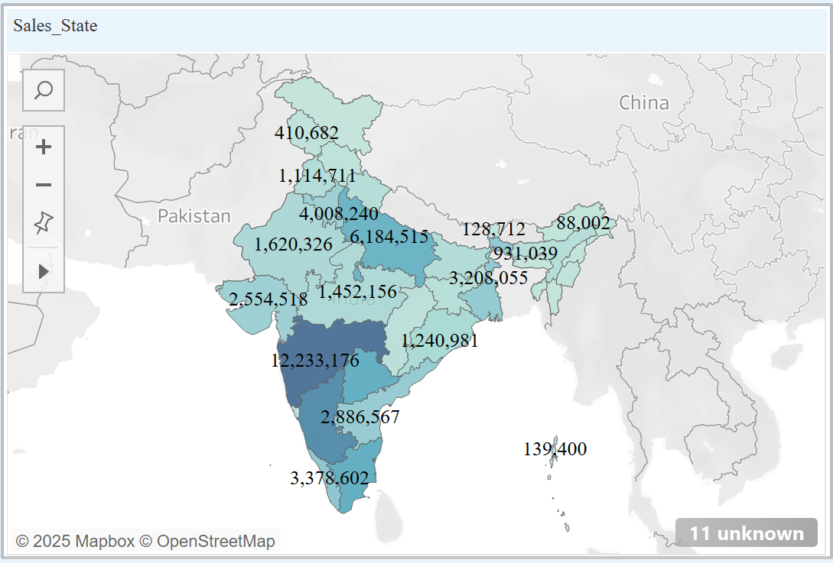
Sales State
Southern and Western states like Maharashtra, Karnataka, and Tamil Nadu have the highest contribution.
Visualizing the data on the map helps identify strong markets and regional opportunities.
Page
09

Slide 10
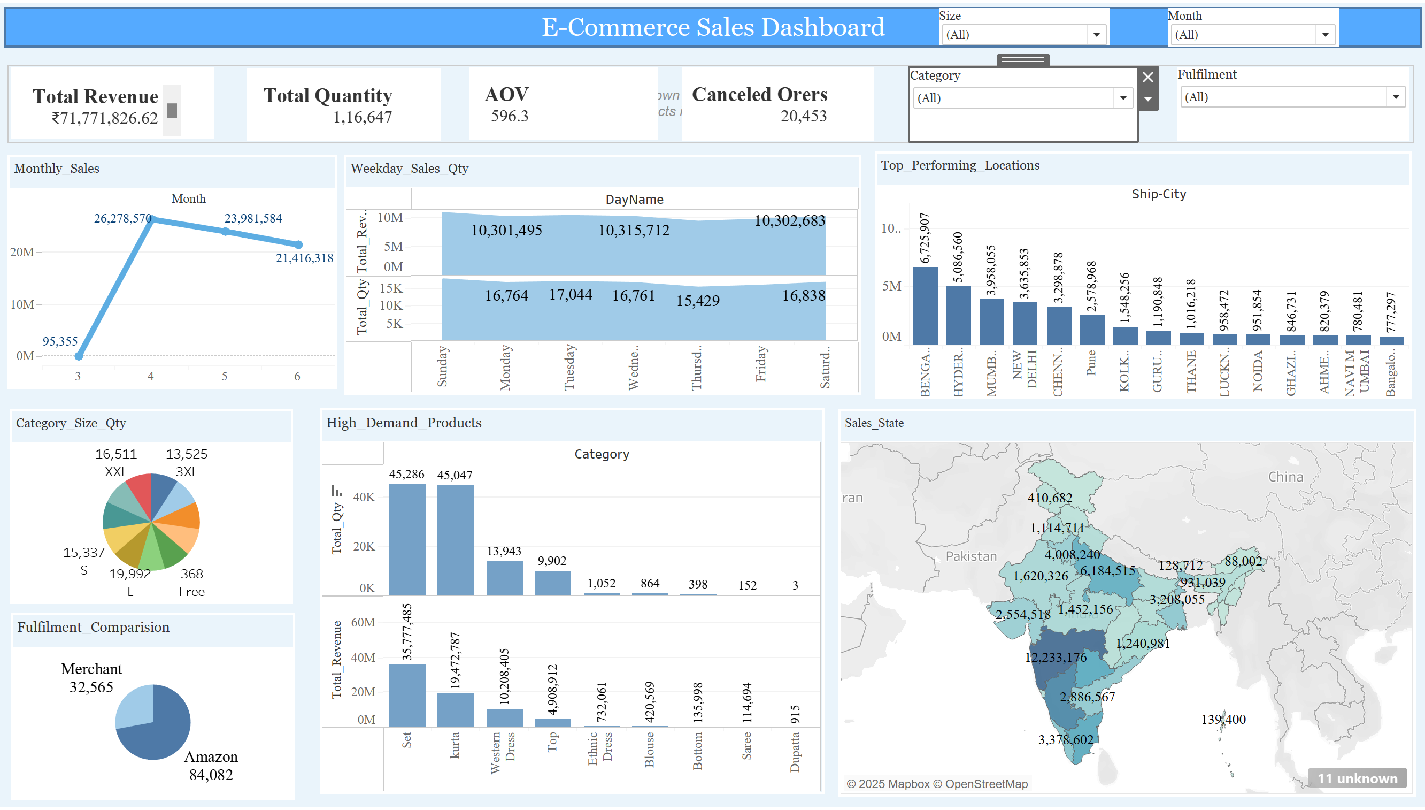
Dashboard Preview
Page
10

Slide 11

Conclusion
The sales performance is strong, with high revenue driven by a few key product categories and regions.
Amazon is the dominant fulfillment partner, and large sizes (like XXL) show higher demand.
Weekday sales are stable, suggesting consistent customer engagement.
Filters provide flexibility to analyze data across dimensions like size, category, month, and fulfillment.
Recommendations include focusing on high-performing cities and optimizing inventory for popular sizes and categories.
Page
11

Slide 12
Recommendation
Fulfilment Optimization
Customer and Market Growth
Product Analysis
Stock more of high demand SKU/Category.
Prioritize fulfilment via more reliable methods.
Offer better services to B2B customers.
Target high revenue cities and reward retained customers.
Analyse high cancelation products/categories
Page
12

Slide 13


2025
Thank
You.
Manan Shah
Manan Shah
Page
13

